Slide 1
Predictive Maintenance and Condition-Based Monitoring for Maritime Drive Systems
Individual Project by:
Vatsal Shah
vatsal793@gmail.com

Slide 2
Problem Statement
Maintaining optimal performance and preventing failures in maritime propulsion systems is crucial for the safety, efficiency, and longevity of vessels.
Gas turbines, which are critical components of these propulsion systems, require advanced techniques for effective monitoring and analysis.
Predictive maintenance and condition-based monitoring can prevent costly failures and enhance operational efficiency, but they depend heavily on accurate forecasting models.
Fleet of ships and requires a predictive maintenance system to reduce downtime and maintenance costs.
The task is to predict the decay state coefficients of the gas turbine (GT) and gas generator (GG) based on various features.

Slide 3
Business Problem
The maritime industry faces significant challenges in ensuring the reliability and performance of gas turbine propulsion systems.
Unplanned downtime due to failures can lead to substantial financial losses and safety risks. Traditional maintenance strategies often fall short in preventing such failures, as they do not leverage the full potential of the available operational data.
Traditional maintenance strategies often fall short in preventing such failures, as they do not leverage the full potential of the available operational data.

Slide 4
Data Summary
Lever position
Ship speed (v)
Gas Turbine (GT) shaft torque (GTT) kN m
GT rate of revolutions (GTn) rpm
Gas Generator rate of revolutions (GGn) rpm
Starboard Propeller Torque (Ts) kN
Port Propeller Torque (Tp) kN
High Pressure (HP) Turbine exit temperature (T48) C
GT Compressor outlet air temperature (T2) C
HP Turbine exit pressure (P48) bar
GT Compressor inlet air pressure (P1) bar
GT Compressor outlet air pressure (P2) bar
GT exhaust gas pressure (Pexh) bar
Turbine Injection Control (TIC) %
Fuel flow (mf) kg/s
GT Compressor decay state coefficient
GT Turbine decay state coefficient
GT Compressor inlet air temperature (T1) C

Slide 5
Approach
1. Business Problem
2. Data Collection and Preprocessing
- Data Cleaning
- Missing Data Handling
- Merging the Datasets
3. Exploratory Data Analysis
- Hypotheses
- Categorical Features
- Continuous Features
- EDA Conclusion and Validating Hypotheses
4. Data Manipulation
- Feature Engineering
- Outlier Detection and Treatment
- Feature Scaling
- Categorical Data Encoding
5. Modeling
- Train Test Split
- Baseline Model - Decision Tree
- Random Forest Model
- Random Forest Hyperparameter Tuning
- Random Forest Feature Importance
6. Model Performance and Evaluation
- Visualizing Model Performances
- Random Forest vs Baseline Model
- Random Forest Tuned vs Baseline and Random Forest Models
7. Store wise Sales Predictions
8. Conclusion and Recommendations

Slide 6
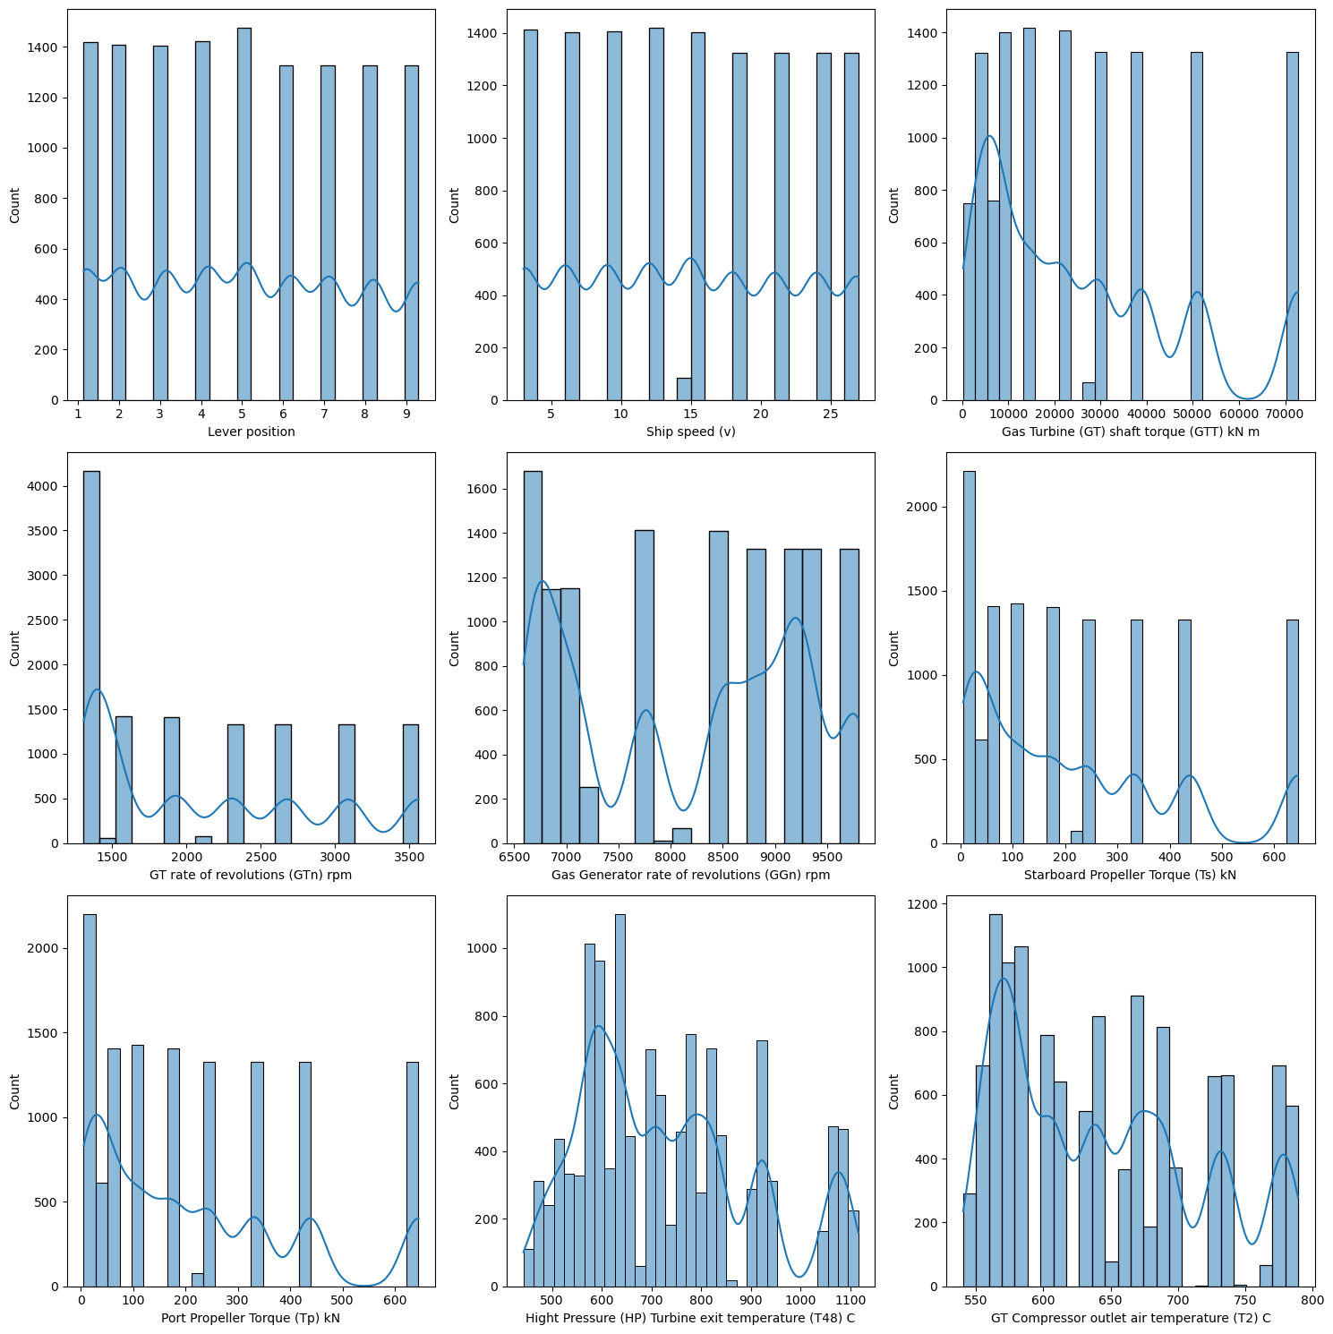
Exploratory Data Analysis
Distributions of Key Features:
Lever Position: The distribution is fairly uniform across different positions, indicating balanced usage.
Ship Speed (v): Shows a multimodal distribution with peaks around certain speeds, suggesting operational preferences or constraints.
GT Shaft Torque (GTT): Also exhibits a multimodal distribution, aligning with varying operational states.
GT Rate of Revolutions (GTn): Indicates common operating ranges with several peaks.
GG Rate of Revolutions (GGn): Shows a similar pattern to GT revolutions, highlighting coordinated operation.
Propeller Torques (Ts and Tp): Both distributions show diverse operational states.
Temperatures (T48 and T2): High peaks suggest frequent operations at specific temperature ranges.

Slide 7
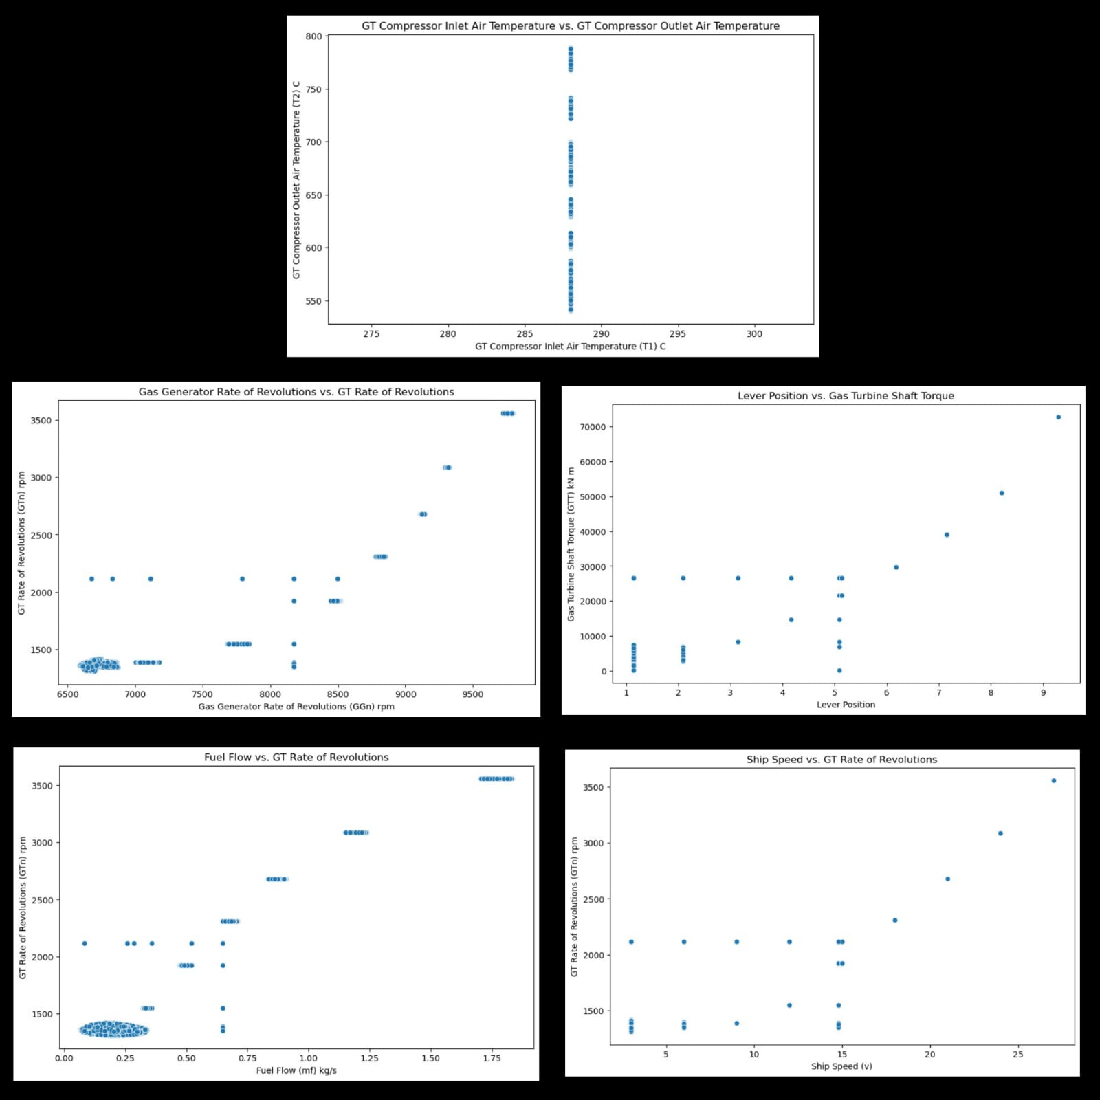
Scatter Plot Analysis
GT Compressor Inlet vs. Outlet Air Temperature: Shows a linear relationship indicating consistent temperature transformation.
GG Rate of Revolutions vs. GT Rate of Revolutions: Displays a strong correlation, reflecting synchronized operation.
Lever Position vs. GT Shaft Torque: A positive trend showing increased torque with higher lever positions.
Fuel Flow vs. GT Rate of Revolutions: Indicates higher fuel flow with increased revolutions, demonstrating expected operational behavior.
Ship Speed vs. GT Rate of Revolutions: A clear linear relationship, confirming that higher ship speeds require more revolutions.

Slide 8
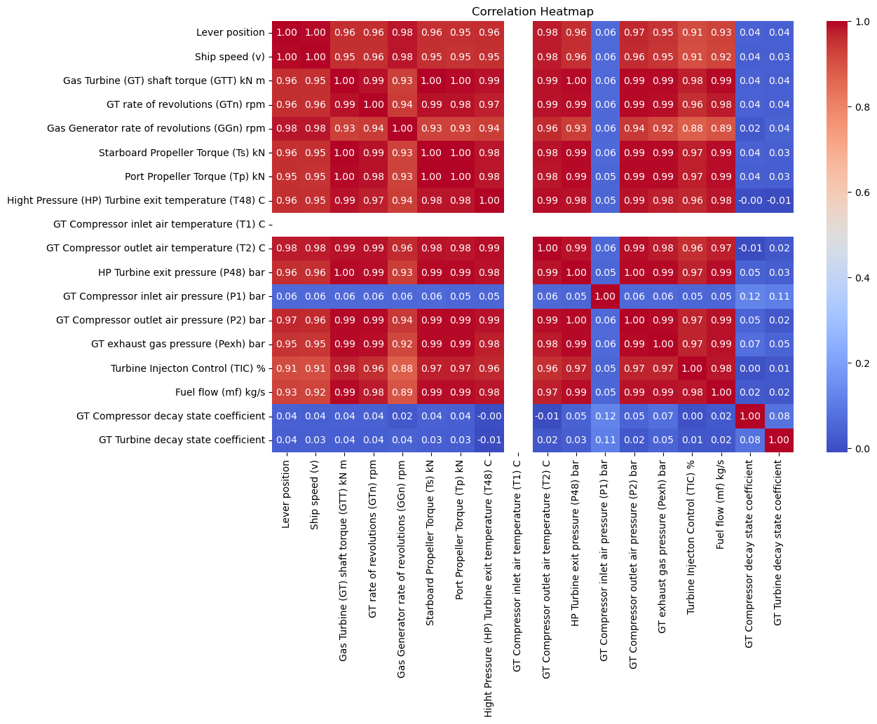
Correlation Heatmap
The correlation heatmap illustrates the relationships between various features in the dataset, helping us identify strong, moderate, and weak correlations.
These insights are crucial for understanding feature dependencies and their impact on the predictive model.
Strong Positive Correlations:
Lever Position, Ship Speed, and GT Shaft Torque: Higher lever positions result in increased ship speed and GT shaft torque.
GT and GG Rates of Revolutions: These features are synchronized, indicating strong operational linkage.
Moderate Positive Correlations:
Temperatures: Various temperature measurements show moderate correlations, indicating consistent thermal behavior.
Pressures and Torque: Moderate correlations highlight interdependence between pressures within the GT compressor and exhaust, and their torques.
Weak or No Correlations:
Decay State Coefficients: These features have weak correlations with others, providing unique information for predictive maintenance.
Impact on the Model:
Redundant Features: Highly correlated features might offer redundant information. Lever position, ship speed, and GT shaft torque are examples.
Unique Features: Weakly correlated features like decay state coefficients are valuable for model accuracy.
Predictive Power: Features with strong correlations to the target variable are more impactful for predictions.

Slide 9
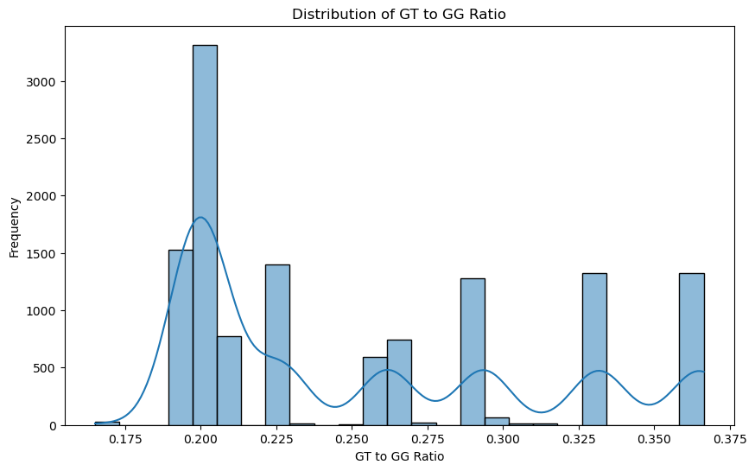
Feature Engineering
Feature engineering is a crucial step in enhancing the performance of machine learning models by creating new features from existing data. In this project, we engineered a new feature called the 'GT to GG Ratio' to provide additional insights and improve model accuracy.
Process:
GT to GG Ratio: This feature was created by dividing the Gas Turbine (GT) rate of revolutions by the Gas Generator (GG) rate of revolutions.
Formula: GT to GG Ratio = GT rate of revolutions (GTn) / Gas Generator rate of revolutions (GGn)
Significance:
Operational Insight: The GT to GG Ratio provides a new perspective on the relationship between the turbine and generator operations. A consistent ratio indicates stable operation, while deviations may signal potential issues.
Model Performance: This feature helps the model capture intricate patterns and dependencies in the data that might not be apparent from the original features alone, thereby enhancing predictive power.

Slide 10
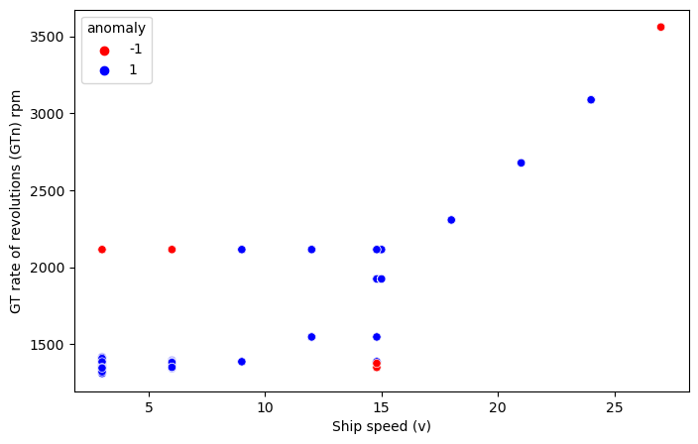
Anomaly Detection
Anomaly detection is a vital component in monitoring and maintaining the health of maritime drive systems. Identifying anomalies helps in preemptive maintenance and avoiding potential failures.
Methods Used:
Isolation Forest: This algorithm was used for detecting anomalies in the dataset. It works by isolating observations by randomly selecting a feature and then randomly selecting a split value between the maximum and minimum values of the selected feature. The anomalies are the points which have shorter average path lengths.
Visualization: Scatter plots were utilized to visualize anomalies. Anomalies are highlighted as red points against normal observations.
Importance:
Early Detection of Issues: By identifying anomalies, we can detect unusual patterns or behaviors that may indicate the onset of mechanical issues.
Preventive Maintenance: Detecting anomalies early allows for timely interventions, reducing downtime and preventing costly repairs.
Operational Efficiency: Maintaining the health of the maritime drive systems through anomaly detection ensures optimal performance and efficiency.

Slide 11
Baseline Model: Decision Tree
A baseline is a simple model that provides reasonable results on a task and does not require much expertise and time to build.
It is well established that there is seasonality involved and no linear relationship is possible to fit.
For these kinds of datasets, tree-based machine learning algorithms are used which are robust to outlier effects and can handle non-linear datasets effectively.
Key Points:
The results show that a simple decision tree is performing pretty well on the validation set but it has completely overfitted the training set.
It's better to have a much more generalized model for future data points.

Slide 12
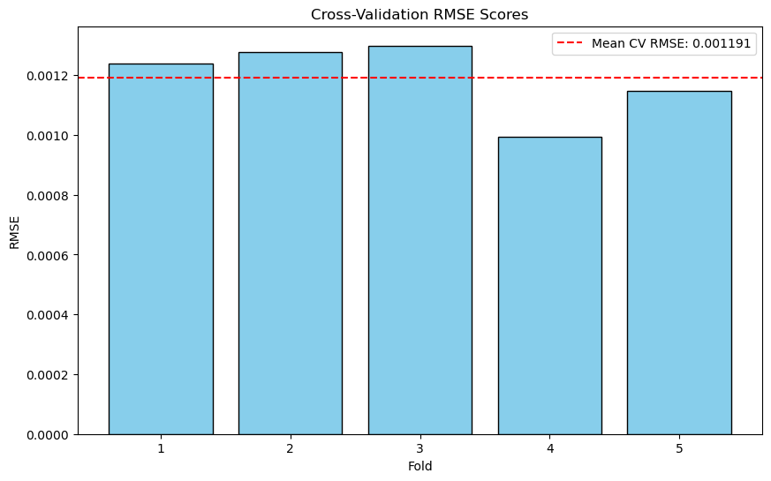
Model Training and Evaluation
The model training and evaluation process involves several key steps to ensure the model's effectiveness and accuracy in predicting the decay state coefficients of the maritime drive systems.
Splitting the Data:
The dataset was split into training and testing sets. Typically, 80% of the data is used for training, and 20% is reserved for testing. This split helps in evaluating the model's performance on unseen data.
Training the Model:
Random Forest Regressor: A Random Forest Regressor was used as the primary model due to its robustness and ability to handle complex relationships within the data.
Hyperparameter Tuning: Grid Search Cross-Validation (GridSearchCV) was employed to tune the hyperparameters and find the best combination for the model. Parameters like the number of estimators, maximum depth, and minimum samples split were optimized.
Evaluating Model Performance:
Cross-Validation: The model's performance was evaluated using 5-fold cross-validation to ensure that it generalizes well to unseen data. Cross-validation helps in assessing the model's stability and robustness.
RMSE (Root Mean Squared Error): RMSE was used as the evaluation metric to measure the differences between predicted and actual values. Lower RMSE values indicate better model performance.

Slide 13
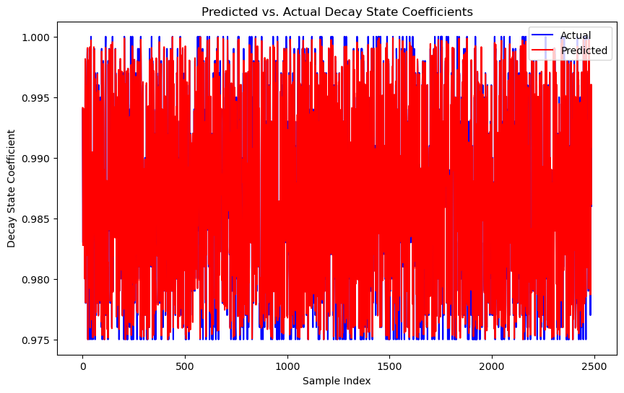

Random Forest Model Performance
Random Forest is an ensemble learning method used for classification and regression.
It builds multiple decision trees and merges them together to get a more accurate and stable prediction.
Model Performance:
Train RMSE: 0.0011466645259836372
Test RMSE: 0.0012740220340222966
Train R²: 0.9157
Test R²: 0.9001
Interpretation:
The model performs well on both the training and test sets, indicating good generalization.
Slight overfitting can be seen as the Train RMSE is slightly lower than the Test RMSE.

Slide 14
Hyperparameter Tuning Results
Hyperparameter tuning was performed to optimize the Random Forest model.
The primary goal was to reduce the Root Mean Squared Error (RMSE) on the test set.
Results:
RMSE of Untuned Random Forest: 0.0011466645259836372
RMSE of Tuned Random Forest: 0.0012740220340222966
Improvement in RMSE: -0.00012735750803865935
Percentage Improvement in RMSE: -11.11%
Interpretation:
Surprisingly, hyperparameter tuning did not improve the model performance and resulted in a higher RMSE.
This suggests that the untuned model was already performing optimally.

Slide 15
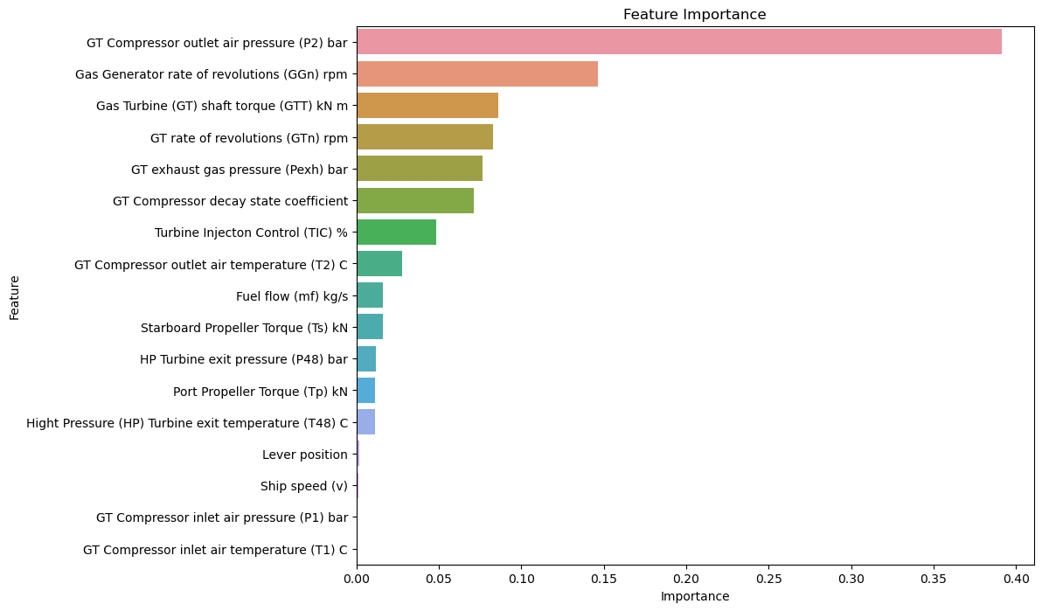
Feature Importance
Understanding feature importance helps in identifying which variables have the most significant impact on the model's predictions. This insight can guide further data collection and feature engineering efforts.
Key Points:
Top Features: GT Compressor outlet air pressure, Gas Generator rate of revolutions, and Gas Turbine shaft torque are among the top features impacting the model.
Impact on Predictions: Features with higher importance scores contribute more to the variance explained by the model, helping in accurate predictions.

Slide 16
Predicted vs. Actual
Comparing predicted values with actual values is essential to evaluate the model's accuracy. This comparison helps in identifying any discrepancies and areas for improvement.
Key Points:
Model Accuracy: The close alignment between predicted and actual values indicates a well-performing model.
Discrepancies: Highlight any significant deviations and potential reasons.

Slide 17
Conclusion and Recommendations
Key Findings:
The model successfully predicts the decay state coefficients with a high degree of accuracy.
Key features such as GT Compressor outlet air pressure and Gas Generator rate of revolutions play a significant role in the predictions.
Recommendations:
Implement Predictive Maintenance Practices: Use the model to proactively schedule maintenance activities and avoid unexpected failures.
Focus on Key Metrics: Prioritize monitoring and optimizing the top features identified by the feature importance analysis.
Continuous Monitoring and Updating: Regularly update the model with new data to maintain its accuracy and relevance.

Slide 18


